Slide 1

Online Sales Management System
Software Testing Final Submission
63 / 63
56
Recorded execution is complete for the documented scope: 63 / 63 cases executed, 56 pass, 7 fail, and 4 confirmed open defects tracked in GitHub.
Recorded execution
Pass
7
4
Team Hoang Van Thien Nguyen Thanh Dat Le Quang Duy
Fail
Open defects
Repository: github.com/Alucard30Dec/Online-Sales-Management-System
Notes:
This is the final testing package for the Online Sales Management System.
Recorded execution is complete at 63 / 63 cases, but the system is not defect-free.
The rest of the deck shows how coverage, evidence, and defect tracking support that conclusion.

Slide 2
01 Project Overview & Scope
System Surfaces And High-Risk Areas
Web-based sales and inventory system. The scope centers on business-critical flows where defects can affect permissions, inventory, transaction status, or reporting.
Highest-Risk Modules - Authentication and permission boundaries - Product import, stock, and inventory movement - Purchase and invoice transaction flows - Reports and public catalog correctness
Admin UI
Public Catalog UI
Authentication, roles, products, purchases, invoices, reports, and stock operations.
Search, sorting, product detail access, and customer-facing catalog behavior.
Health API
Catalog API
Environment readiness smoke used to validate API availability before deeper runs.
Filtering, paging, sort, and boundary behavior through Newman collection runs.
Why this matters These areas can create false stock, invalid revenue records, or unauthorized access if they break.
Notes:
The system includes admin workflows, public catalog pages, and a small API surface.
These modules are suitable for testing because defects can affect permissions, stock, and transaction correctness.
The highest-risk modules drove the scope and the defect focus.

Slide 3
02 Team & Task Allocation
Ownership Is Split By Module And UI Test Cases
Each member owns a non-overlapping UI subset and one clear module cluster.
Hoang Van Thien
17 UI cases
Auth + permissions
Users/groups + reports
Invoices + public UI
Nguyen Thanh Dat
13 UI cases
Customers + suppliers
Purchases
Stock (partial)
Le Quang Duy
14 UI cases
Products
Import + stock (partial)
Public catalog
17 + 13 + 14 = 44 UI cases. Every member stays above the 10-case requirement, and ownership stays non-overlapping.
Notes:
Each member owns a non-overlapping UI subset.
The ownership split is 17, 13, and 14 UI cases, so everyone stays above the 10-case requirement.
Module ownership also made evidence and Q&A easier to defend.

Slide 4
03 Test Strategy & Approach
Manual Execution Drives Coverage; Automation Adds Repeatability
The strategy combines manual UI testing, API regression, selective automation, and source-informed edge-case design.
Approach
- risk-based scope and business-critical flows
- manual UI execution plus API regression
- selective automation for repeatable smoke and reruns
Design logic
- black-box execution for visible behavior
- white-box-informed design for routes, roles, and validation paths
- entry: runnable app + seeded data
- exit: all cases executed and evidence synchronized
Scenario
Test Case
Execution
Evidence
Defect Log
GitHub Issue
Defense point
This chain is the core review answer: each reported result can be traced from scenario and test case to runtime evidence and, when confirmed as a defect, to a live GitHub issue.
Notes:
The strategy is risk-based: manual UI execution first, API regression next, and selective automation for repeatable flows.
Execution is black-box, but source inspection was used to design edge cases and role checks.
The key defense point is the chain from scenario to GitHub issue.

Slide 5
04 Environment & Tools
The Test Environment Was Controlled, Local, And Repeatable
The same environment supported manual execution, UI automation, API regression, screenshots, metrics export, and GitHub-based defect tracking.
Environment - Windows 11 workstation - ASP.NET Core MVC (.NET 8) - localhost:5068 - local seeded test data
Browsers and devices - Chrome as main UI baseline - Edge for focused smoke rerun - desktop environment only
Core tools - Selenium - xUnit - Postman - Newman - GitHub Issues
.NET 8
Windows 11
Chrome
Edge
localhost:5068
Selenium
xUnit
Postman
Newman
GitHub Issues
This environment is enough to justify functional execution, automation artifacts, and issue-tracker evidence, but not enough to claim production-like deployment coverage.
Notes:
All verified outputs came from the same local environment.
That environment is enough for functional verification and evidence capture, but not for production-like claims.
Edge is included only as a focused smoke rerun, not as full browser certification.

Slide 6
05 Coverage & Ownership
Coverage Is Complete, And Ownership Stays Non-Overlapping
The final case set covers the documented scope and still keeps individual UI ownership clear enough to defend.
42
63
44 UI / 19 API
All >10 UI cases
Documented scenarios
Total test cases
Design split
Requirement fit
Ownership check
17 / 13 / 14
UI ownership stays non-overlapping
Why it matters
- all 44 UI cases are assigned once
- every member stays above 10 cases
- module ownership is easier to defend
Coverage is complete for the documented scope, but the remaining 7 fails still map to 4 confirmed open defects.
Notes:
We documented 42 scenarios and designed 63 cases, split into 44 UI and 19 API.
UI ownership remains non-overlapping and sums cleanly to 44.
Coverage is complete in the recorded scope, but complete coverage does not mean defect-free behavior.

Slide 7
06 Automation Support
Automation Adds Repeatability To The Recorded Baseline
Selenium and Newman strengthen the evidence set, but final status still depends on runtime behavior recorded in the workbooks.
.NET UI support
- .NET 8, xUnit, Selenium
- page objects, waits, and screenshot helper
- focused login, permission, and rerun coverage
API support
- Postman collection + Newman
- text and XML runner artifacts
- repeatable health and catalog regression
What was actually automated
- TC-UI-AUTH-001 smoke rerun
- TC-UI-IMP-002 preview validation
- TC-API-HLT-001 in Newman
- focused reruns for confirmed defects
Execution principle
Automation is used for repeatability, smoke support, and bonus evidence. Final status still depends on visible runtime behavior, screenshots, runner outputs, and the synchronized result files.
Notes:
Automation supports repeatability and bonus coverage; it does not replace final manual status decisions.
The real automated pieces are Selenium UI checks and Newman API runs.
Runtime screenshots, TRX files, and Newman outputs back up the automated claims.

Slide 8
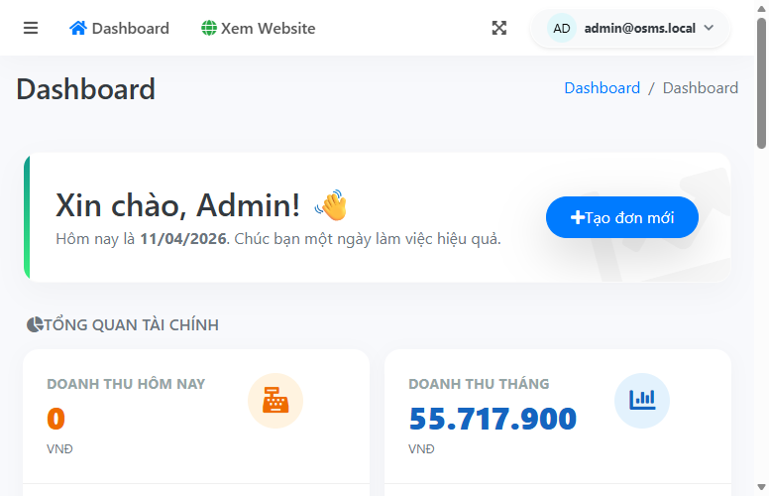
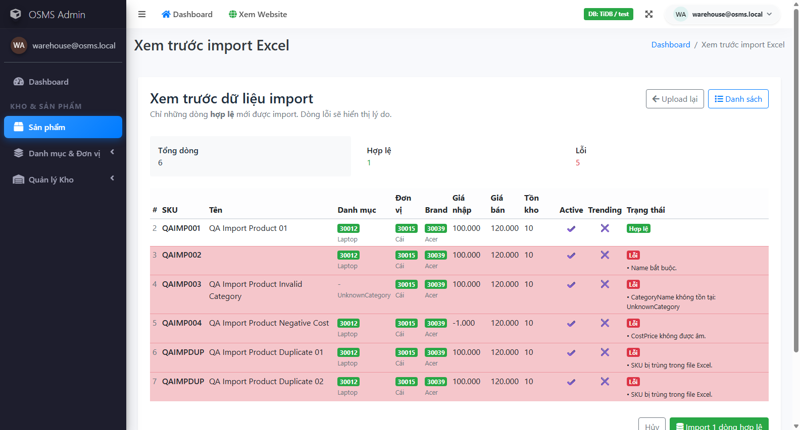
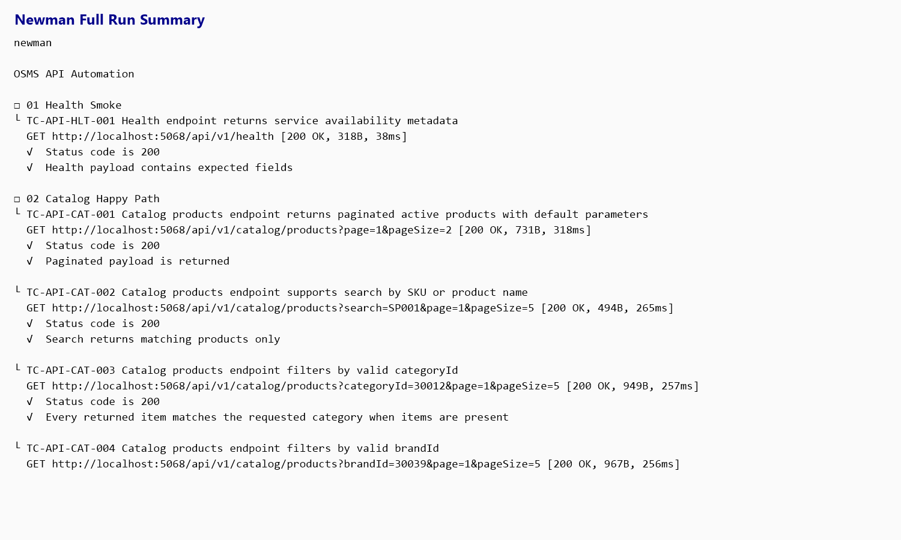
07 Evidence-First Execution
Real Runtime Output Supports Both Pass And Fail Results
The deck only uses recorded screenshots and runner artifacts that already exist in the submission package.
Traceability rules
- pass requires runtime proof
- fail requires mismatch plus evidence
- confirmed defects link to GitHub issues
Fail areas shown in scope
- purchase validation banner
- import confirm flow
- invoice create flow
- invoice cancel flow
TC-UI-AUTH-001 pass on focused login smoke
TC-UI-IMP-002 preview shows 6 / 1 / 5 counts
Newman full run proves API regression passed 19 / 19
Notes:
This slide shows the evidence types actually used in the submission.
A pass still needs runtime proof, and a fail needs a visible mismatch plus supporting artifacts.
The failure evidence shown here matches the open defects in the final report.

Slide 9
08 Result Comparison
Two Pass Cases And Two Fail Cases Show How Status Was Assigned
Each status below is grounded in expected-versus-actual behavior and linked evidence, not summary labels alone.
TC-UI-AUTH-001
Pass
TC-UI-IMP-002
Pass
Valid admin login reaches dashboard
Import preview shows valid and invalid counts
Expected Admin login must redirect to dashboard without validation error.
Expected Preview must show row counts and row-level validation info.
Actual Chrome and Edge smoke reruns both reached the dashboard.
Actual Preview showed 6 total, 1 valid, and 5 invalid rows.
Evidence: screenshot + smoke TRX
Evidence: screenshot + rerun TRX
TC-UI-PUR-002
Fail
TC-UI-INV-001
Fail
Readable supplier validation should be shown
Valid walk-in invoice should be created
Expected Supplier-missing submission should show a readable error.
Expected A valid unpaid invoice should redirect to invoice details.
Actual Submission was blocked, but the validation banner remained unreadable.
Actual Create returned to the form with a failure toast and still reproduced.
Evidence: screenshot + GitHub issue #2 + rerun TRX
Evidence: screenshot + GitHub issue #1 + rerun TRX
Notes:
These four cases show how status was assigned in the workbook.
The pass cases prove successful runtime behavior; the fail cases show real expected-versus-actual mismatches.
Each failing case is linked to reruns or GitHub issues, not only a screenshot.

Slide 10
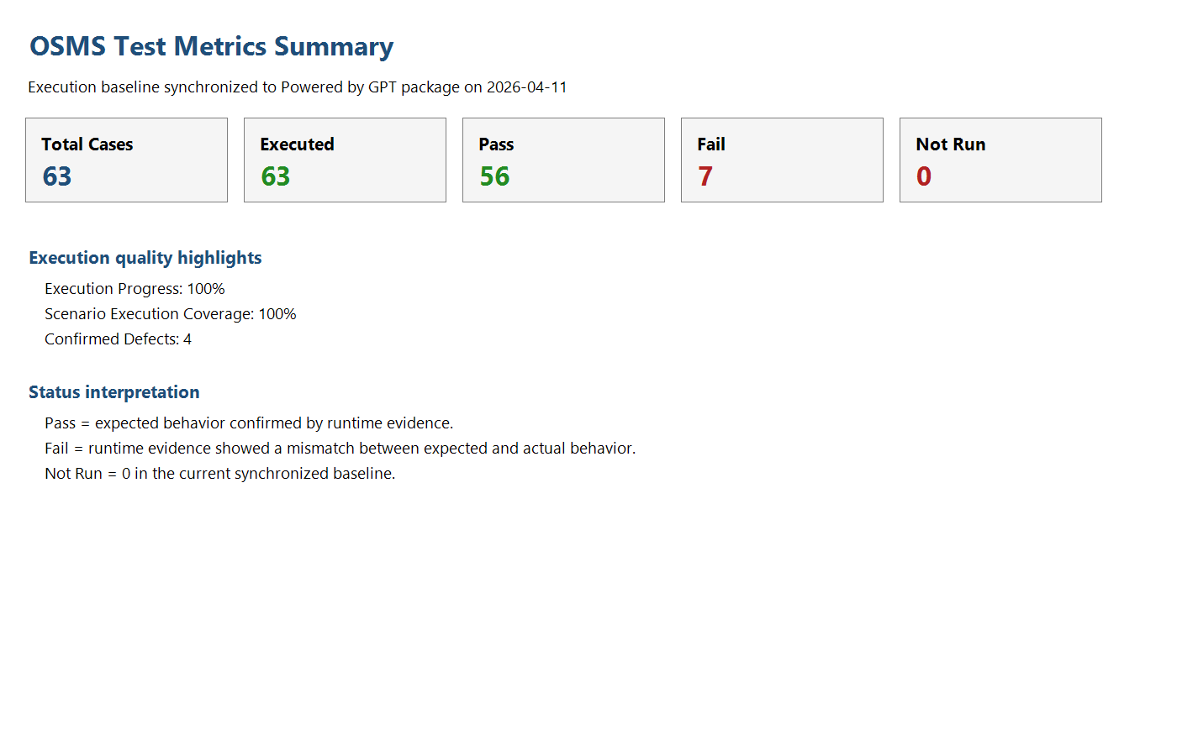
09 Metrics Snapshot
Execution Is Complete, Stability Is Not Yet Complete
The metrics prove complete recorded execution, while the fail and defect counts show why the product is not yet defect-free.
63 / 63
56 pass
Executed cases
Pass rate 88.89%
7 fail
4 live issues
Fail rate 11.11%
Confirmed defects in GitHub
Interface view
- Admin UI: 41 executed
- API: 19 executed and fully passed
- Public UI: 3 executed
Interpretation
Full execution proves coverage, not a defect-free system.
Metrics workbook snapshot as of 2026-04-11
Notes:
The execution metrics separate coverage from product stability.
63 / 63 executed proves completeness of the run, not product correctness.
The 7 failing cases map to 4 confirmed defects, which is why fail count and defect count are different.

Slide 11
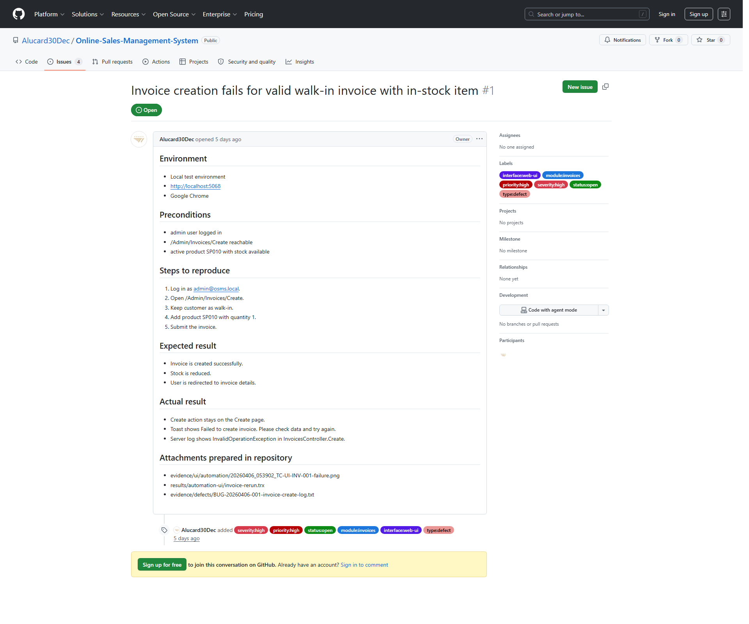
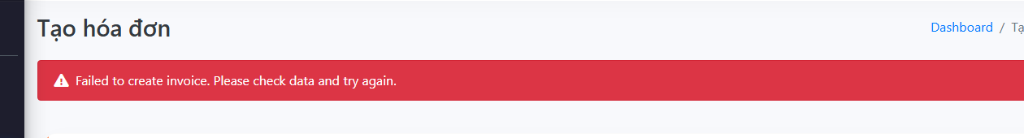
10 Defect Deep Dive
BUG-20260406-001 Blocks Valid Invoice Creation
This is the strongest defect for defense because it blocks the base invoice-create flow and also affects related invoice scenarios.
Summary
ID: BUG-20260406-001
Module: Invoices
Severity / Priority: High / High
Status: Open - Confirmed
Steps
1 Log in as admin
2 Open /Admin/Invoices/Create
3 Add SP010 qty 1 for walk-in sale
4 Submit invoice
Expected vs actual
Expected: invoice opens details.
Actual: create stays on the form and shows a failure toast.
Representative GitHub issue #1 for BUG-20260406-001
Impact / links
Related: TC-UI-INV-001, -003, -006
Evidence: failure screenshot + GitHub issue #1 + rerun TRX + server log
Open defect summary: #1 invoice create, #2 purchase banner, #3 import confirm, #4 invoice cancel.
Notes:
The strongest defect is BUG-20260406-001 because it blocks the base invoice-create flow.
It also affects related invoice scenarios, so it is a better defense example than a cosmetic issue.
The screenshot, rerun artifacts, and live GitHub issue all point to the same unresolved behavior.

Slide 12
11 Final Assessment
What Is Proven Today, And What Still Needs Code Fixes
The final assessment is intentionally split between what the evidence proves now and what depends on future product changes.
Proven today
- 63 / 63 cases executed
- 42 documented scenarios mapped to cases
- evidence chain runs from scenario to issue tracker
- submission package is complete and reviewable
Still open
- 4 confirmed defects remain unresolved
- post-fix retest still depends on code changes
- browser proof beyond Edge smoke is not claimed
- invoice and import remain the highest-risk flows
1
2
3
Fix invoice create and invoice cancel first
Fix purchase validation and import confirm
Rerun failed cases and attach post-fix evidence
Notes:
This slide separates what the evidence proves today from what still depends on code fixes.
The submission is complete and defensible, but the open defects remain open.
The next engineering step is code fix plus focused retest, not rewriting the report.

Slide 13
12 Closing / Q&A
The Package Is Ready For Review, And The Open Risks Are Clear
This closing slide stays short so the team can move directly into Q&A and open the backup slides only when needed.
63 / 63
4 open
Evidence-first
Recorded execution coverage
Confirmed defects still active
Screenshots, runner files, workbooks, and issues stay aligned
Closing message
- the report package is complete and reviewable
- the key claims are backed by workbooks, runner files, screenshots, and issues
- open defects are real and already tracked in GitHub
- the next engineering step is code fix plus focused retest
Thank you. We are ready for questions.
Notes:
The main deck stops here on purpose.
Backup slides exist for package structure, sample testcase format, and full defect summary.
If asked why the submission is still valid with open defects, the answer is that defect management is part of the required outcome.

Slide 14
Backup A
Submission Package Structure
This slide supports questions about where the examiner can find the report, evidence, scripts, and video.
MainReport
TestCases
TestResults
Word report and slides
UI and API case files
Results, metrics, and evidence
TestScript-Data
Videos
Automation scripts and test data
Automation demo
How to read the package
- MainReport contains the Word report and presentation
- TestCases contains the UI and API case files
- TestResults contains execution outcomes, metrics, runner outputs, and defect evidence
- TestScript-Data contains automation scripts and test data
- Videos contains the automation demo
Notes:
This backup slide shows where the examiner can find each required artifact in the package.
It is useful when questions move from the slides to the actual submission folder.

Slide 15
Backup B
Sample UI Test Case Format
The UI testcase artifacts follow the required field structure: ID, title, preconditions, steps, expected result, actual result, status, and evidence.
Sample case ID: TC-UI-AUTH-001 Title: Login succeeds with valid admin account Owner: Hoang Van Thien Module: Authentication Priority: Critical Status: Pass
Preconditions and steps Preconditions: Application is running locally and seeded admin account exists. Steps: 1 Open /Admin/Auth/Login; 2 Enter admin email; 3 Enter valid password; 4 Click Sign in. Test data: Email=admin@osms.local; Password=Admin@12345
Outcome fields Expected: User is redirected to the admin area dashboard; authenticated session is established; no validation error is shown. Actual: Valid admin login reached the admin dashboard successfully in both the focused Chrome rerun and a secondary Edge smoke rerun on 2026-04-11. Evidence: TestResults/Evidence/UI/automation/20260406_053930_TC-UI-AUTH-001-success.png ; TestResults/Evidence/UI/automation/20260411_143741_TC-UI-AUTH-001-success.png ; TestResults/RunnerOutput/UI/auth-permission-rerun.trx ; TestResults/RunnerOutput/UI/edge-auth-smoke.trx ; Videos/OSMS-Automation-Demo.mp4
Notes:
This shows that the UI testcase format meets the brief: ID, title, preconditions, steps, expected, actual, status, and evidence.

Slide 16
Backup C
Sample API Test Case Format
The API testcase artifacts include endpoint, method, parameters, expected status, expected body, actual result, status, and evidence.
Sample case ID: TC-API-HLT-001 Title: Health endpoint returns service availability metadata Module: Health API Method: GET Endpoint: /api/v1/health Priority: Medium Status: Pass
Request side Auth: None Params / Body: No params; body=N/A Test data: Base URL=http://localhost:5068 Steps: 1 Ensure the application is running locally; 2 Send GET request to http://localhost:5068/api/v1/health using Postman or browser.
Expected and actual Expected status: 200 Expected body: JSON response contains non-empty fields for status, service, serverTimeUtc, and version; status value is ok. Actual: Health endpoint returned 200 OK and all Newman assertions for status, service, serverTimeUtc, and version passed in the full collection rerun. Evidence: Primary evidence: TestResults/Evidence/API/newman-full-run.txt ; Secondary artifact: TestResults/RunnerOutput/API/newman-results.xml
Notes:
This shows the same standard for API cases, plus endpoint and method details.

Slide 17
Backup D
Full Confirmed Defect Summary
This slide supports questions about the defect count, severity split, related cases, and issue-tracker links.
BUG-20260406-001 | Module: Invoices | Severity: High | Priority: High | Status: Open - Confirmed | GitHub issue #1 | Related cases: TC-UI-INV-001; TC-UI-INV-003; TC-UI-INV-006
BUG-20260411-002 | Module: Purchases | Severity: Medium | Priority: Medium | Status: Open - Confirmed | GitHub issue #2 | Related cases: TC-UI-PUR-002; TC-UI-PUR-003
BUG-20260411-003 | Module: Product Import | Severity: High | Priority: High | Status: Open - Confirmed | GitHub issue #3 | Related cases: TC-UI-IMP-003
BUG-20260411-004 | Module: Invoices | Severity: High | Priority: High | Status: Open - Confirmed | GitHub issue #4 | Related cases: TC-UI-INV-005
Severity split confirmed from the defect register: 3 High, 1 Medium, 0 Critical, 0 Low.
Notes:
This slide lists all confirmed open defects and their severity split.
It helps answer questions about count, ownership, and issue tracking.

